Slide 1
Relations
Chapter 9

Slide 2
Chapter Summary
Relations and Their Properties
n-ary Relations and Their Applications (not currently included in overheads)
Representing Relations
Closures of Relations (not currently included in overheads)
Equivalence Relations
Partial Orderings

Slide 3
Relations and Their Properties
Section 9.1

Slide 4
Section Summary
Relations and Functions
Properties of Relations
Reflexive Relations
Symmetric and Antisymmetric Relations
Transitive Relations
Combining Relations

Slide 5
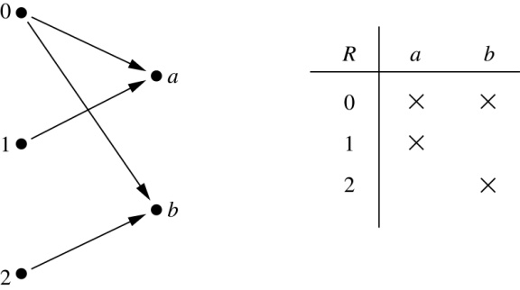
Binary Relations
Definition: A binary relation R from a set A to a set B is a subset R ⊆ A × B.
Example:
Let A = {0,1,2} and B = {a,b}
{(0, a), (0, b), (1,a) , (2, b)} is a relation from A to B.
We can represent relations from a set A to a set B graphically or using a table:
Relations are more general than functions. A function is a relation where exactly one element of B is related to each element of A.

Slide 6
Binary Relation on a Set
Definition: A binary relation R on a set A is a subset of A × A or a relation from A to A.
Example:
Suppose that A = {a,b,c}. Then R = {(a,a),(a,b), (a,c)} is a relation on A.
Let A = {1, 2, 3, 4}. The ordered pairs in the relation R = {(a,b) | a divides b} are
(1,1), (1, 2), (1,3), (1, 4), (2, 2), (2, 4), (3, 3), and (4, 4).

Slide 7
Binary Relation on a Set (cont.)
Question: How many relations are there on a set A?
Solution: Because a relation on A is the same thing as a subset of A ⨉ A, we count the subsets of A × A. Since A × A has n² elements when A has n elements, and a set with m elements has 2^{m} subsets, there are subsets of A × A. Therefore, there are relations on a set A.

Slide 8
Binary Relations on a Set (cont.)
Example: Consider these relations on the set of integers:
R₁ = {(a,b) | a ≤ b}, R₄ = {(a,b) | a = b},
R₂ = {(a,b) | a > b}, R₅ = {(a,b) | a = b + 1},
R₃ = {(a,b) | a = b or a = −b}, R₆ = {(a,b) | a + b ≤ 3}.
Which of these relations contain each of the pairs
(1,1), (1, 2), (2, 1), (1, −1), and (2, 2)?
Solution: Checking the conditions that define each relation, we see that the pair (1,1) is in R₁, R₃, R₄ , and R₆: (1,2) is in R₁ and R₆: (2,1) is in R₂, R₅, and R₆: (1, −1) is in R₂, R₃, and R₆ : (2,2) is in R₁, R₃, and R₄.
Note that these relations are on an infinite set and each of these relations is an infinite set.

Slide 9
Reflexive Relations
Definition: R is reflexive iff (a,a) ∊ R for every element a ∊ A. Written symbolically, R is reflexive if and only if
∀x[x∊U ⟶ (x,x) ∊ R]
Example: The following relations on the integers are reflexive:
R₁ = {(a,b) | a ≤ b},
R₃ = {(a,b) | a = b or a = −b},
R₄ = {(a,b) | a = b}.
The following relations are not reflexive:
R₂ = {(a,b) | a > b} (note that 3 ≯ 3),
R₅ = {(a,b) | a = b + 1} (note that 3 ≠3 + 1),
R₆ = {(a,b) | a + b ≤ 3} (note that 4 + 4 ≰ 3).
If A = ∅ then the empty relation is reflexive vacuously. That is the empty relation on an empty set is reflexive!

Slide 10
Symmetric Relations
Definition: R is symmetric iff (b,a) ∊ R whenever (a,b) ∊ R for all a,b ∊ A. Written symbolically, R is symmetric if and only if
∀x∀y [(x,y) ∊R ⟶ (y,x) ∊ R]
Example: The following relations on the integers are symmetric:
R₃ = {(a,b) | a = b or a = −b},
R₄ = {(a,b) | a = b},
R₆ = {(a,b) | a + b ≤ 3}.
The following are not symmetric:
R₁ = {(a,b) | a ≤ b} (note that 3 ≤ 4, but 4 ≰ 3),
R₂ = {(a,b) | a > b} (note that 4 > 3, but 3 ≯ 4),
R₅ = {(a,b) | a = b + 1} (note that 4 = 3 + 1, but 3 ≠4 + 1).

Slide 11
Antisymmetric Relations
Definition:A relation R on a set A such that for all a,b ∊ A if (a,b) ∊ R and (b,a) ∊ R, then a = b is called antisymmetric. Written symbolically, R is antisymmetric if and only if
∀x∀y [(x,y) ∊R ∧ (y,x) ∊ R ⟶ x = y]
Example: The following relations on the integers are antisymmetric:
R₁ = {(a,b) | a ≤ b},
R₂ = {(a,b) | a > b},
R₄ = {(a,b) | a = b},
R₅ = {(a,b) | a = b + 1}.
The following relations are not antisymmetric:
R₃ = {(a,b) | a = b or a = −b}
(note that both (1,−1) and (−1,1) belong to R₃),
R₆ = {(a,b) | a + b ≤ 3} (note that both (1,2) and (2,1) belong to R₆).
For any integer, if a a ≤ b and b ≤ a , then a = b.

Slide 12
Transitive Relations
Definition: A relation R on a set A is called transitive if whenever (a,b) ∊ R and (b,c) ∊ R, then (a,c) ∊ R, for all a,b,c ∊ A. Written symbolically, R is transitive if and only if
∀x∀y ∀z[(x,y) ∊R ∧ (y,z) ∊ R ⟶ (x,z) ∊ R ]
Example: The following relations on the integers are transitive:
R₁ = {(a,b) | a ≤ b},
R₂ = {(a,b) | a > b},
R₃ = {(a,b) | a = b or a = −b},
R₄ = {(a,b) | a = b}.
The following are not transitive:
R₅ = {(a,b) | a = b + 1} (note that both (3,2) and (4,3) belong to R₅, but not (3,3)),
R₆ = {(a,b) | a + b ≤ 3} (note that both (2,1) and (1,2) belong to R₆, but not (2,2)).
For every integer, a ≤ b
and b ≤ c, then a ≤ c.

Slide 13
Combining Relations
Given two relations R₁ and R₂, we can combine them using basic set operations to form new relations such as R₁ ∪ R₂, R₁ ∩ R₂, R₁ − R₂, and R₂ − R₁.
Example: Let A = {1,2,3} and B = {1,2,3,4}. The relations R₁ = {(1,1),(2,2),(3,3)} and R₂ = {(1,1),(1,2),(1,3),(1,4)} can be combined using basic set operations to form new relations:
R₁ ∪ R₂ ={(1,1),(1,2),(1,3),(1,4),(2,2),(3,3)}
R₁ ∩ R₂ ={(1,1)}
R₁ − R₂ ={(2,2),(3,3)}
R₂ − R₁ ={(1,2),(1,3),(1,4)}

Slide 14
Composition
Definition: Suppose
R₁ is a relation from a set A to a set B.
R₂ is a relation from B to a set C.
Then the composition (or composite) of R₂ with R₁, is a relation from A to C where
if (x,y) is a member of R₁ and (y,z) is a member of R₂, then (x,z) is a member of R₂∘ R₁.

Slide 15
Representing the Composition of a Relation
R₁
R₂
w
m
a
x
n
b
y
o
c
p
z
R₁∘ R₂ = {(b,D),(b,B)}

Slide 16
Powers of a Relation
Definition: Let R be a binary relation on A. Then the powers R^{n} of the relation R can be defined inductively by:
Basis Step: R¹ = R
Inductive Step: R^{n+1} = R^{n} ∘ R
(see the slides for Section 9.3 for further insights)
The powers of a transitive relation are subsets of the
relation. This is established by the following theorem:
Theorem 1: The relation R on a set A is transitive iff R^{n} ⊆ R for n = 1,2,3 ….
(see the text for a proof via mathematical induction)

Slide 17
Representing Relations
We have seen one way to graphically represent a function/relation between two (different) sets: Specifically as a directed graph with arrows between nodes that are related
We will look at two alternative ways to represent relations
0-1 matrices (bit matrices)
Directed graphs

Slide 18
0-1 Matrices (1)
A 0-1 matrix is a matrix whose entries are 0 or 1
Let R be a relation from A={a₁,a₂,…,a_{n}} and B={b₁,b₂,…,b_{n}}
Let’s impose an ordering on the elements in each set. Although this ordering is arbitrary, it is important that it remain consistent. That is, once we fix an ordering, we have to stick to it.
When A=B, R is a relation on A and we choose the same ordering in the two dimensions of the matrix

Slide 19
0-1 Matrix (2)
The relation R can be represented by a (n×m) sized 0-1 matrix M_{R}=[m_{i,j}] as follows
Intuitively, the (i,j)-th entry if 1 if and only if a_{i}∈A is related to b_{i}∈B
 |  | 1 if (a_{i},b_{i}) ∈ R
m_{i,j} =
 |  | 0 if (a_{i},b_{i}) ∉ R

Slide 20
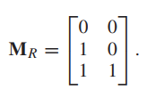
Example 1
Suppose that A = {1, 2, 3} and B = {1, 2}. Let R be the relation from A to B containing (a, b) if a ∈ A, b ∈ B, and a > b. What is the matrix representing R if a1 = 1, a2 = 2, and a3 = 3, and b1 = 1 and b2 = 2?
Because R = {(2, 1), (3, 1), (3, 2)}, the matrix for R is
The 1s in M_{R} show that the pairs (2, 1), (3, 1), and (3, 2) belong to R. The 0s show that no other pairs belong to R

Slide 21
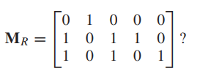
Example 2
Let A = {a1, a2, a3} and B = {b1, b2, b3, b4, b5}. Which ordered pairs are in the relation R represented by the matrix
Because R consists of those ordered pairs (a_{i}, b_{j}) with m_{ij} = 1, it follows that R = {(a1, b2), (a2, b1), (a2, b3), (a2, b4), (a3, b1), (a3, b3), (a3, b5)}.

Slide 22
The matrix of a relation on a set, which is a square matrix, can be used to determine whether the relation has certain properties.
Recall that are relation R on A is reflexive if (a, a) ∈ R whenever a ∈ A. Thus, R is reflexive if and only if (a_{i}, a_{i}) ∈ R for i = 1, 2, . . . , n. Hence, R is reflexive if and only if m_{ii} = 1, for i = 1, 2, . . . , n.
In other words, R is reflexive if all the elements on the main diagonal of M_{R} are equal to 1, as shown in Figure 1. Note that the elements off the main diagonal can be either 0 or 1.

Slide 23
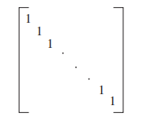
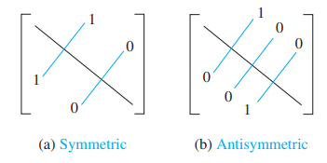
Representation
The Zero–One Matrix for a Reflexive Relation. (Off Diagonal Elements Can Be 0 or 1.)
The Zero–One Matrices for Symmetric and Antisymmetric Relations.

Slide 24

The relation R is symmetric if (a, b) ∈ R implies that (b, a) ∈ R. Consequently, the relation R on the set A = {a₁, a₂, . . . , a_{n}} is symmetric if and only if (a_{j}, a_{i}) ∈ R whenever (a_{i}, a_{j}) ∈ R.
In terms of the entries of M_{R}, R is symmetric if and only if m_{ji} = 1 whenever m_{ij} = 1. This also means m_{ji} = 0 whenever m_{ij} = 0. Consequently, R is symmetric if and only if m_{ij} = m_{ji}, for all pairs of integers i and j with i = 1, 2, . . . , n and j = 1, 2, . . . , n.
Recalling the definition of the transpose of a matrix we see that R is symmetric if and only if
that is, if M_{R} is a symmetric matrix. The form of the matrix for a symmetric relation is illustrated in Figure 2 (a)

Slide 25
The relation R is antisymmetric if and only if (a, b) ∈ R and (b, a) ∈ R imply that a = b.
Consequently, the matrix of an antisymmetric relation has the property that if m_{ij} = 1 with i ≠ j, then m_{ji} = 0. Or, in other words, either m_{ij} = 0 or m_{ji} = 0 when i ≠ j.
The form of the matrix for an antisymmetric relation is illustrated in Figure 2(b).

Slide 26
0-1 Matrix (3)
An important note: the choice of row-major or column-major form is important.
The (i,j)^{th} entry refers to the i-th row &the j-th column.
The size, (n×m), refers to the fact that M_{R} has n rows and m columns
Though the choice is arbitrary, switching between row-major and column-major is a bad idea, because when A≠B, the Cartesian Product A×B ≠ B×A
In matrix terms, the transpose, (M_{R})^{T} does not give the same relation. This point is uncertain for A=B.

Slide 27
0-1 Matrix (4)
 |  | B
 |  |  | b₁ | b₂ | b₃ | b₄
A | a₁ |  | 0 | 0 | 1 | 0
 | a₂ |  | 1 | 1 | 1 | 1
 | a₃ |  | 0 | 0 | 1 | 1
 | a₄ |  | 1 | 0 | 1 | 1

Slide 28

Suppose that the relation R on a set is represented by the matrix
Is R reflexive, symmetric, and/or antisymmetric?
Because all the diagonal elements of this matrix are equal to 1, R is reflexive. Moreover, because M_{R} is symmetric, it follows that R is symmetric. It is also easy to see that R is not antisymmetric.

Slide 29

The Boolean operations join and meet can be used to find the matrices representing the union and the intersection of two relations. Suppose that R1 and R2 are relations on a set A represented by the matrices M_{R1} and M_{R2}, respectively.
The matrix representing the union of these relations has a 1 in the positions where either M_{R1} or M_{R2} has a 1. The matrix representing the intersection of these relations has a 1 in the positions where both MR1 and MR2 have a 1. Thus, the matrices representing the union and intersection of these relations are

Slide 30
Matrix Representation: Example
Consider again the example
A={a₁,a₂,a₃,a₄,a₅} and B={b₁,b₂,b₃}
Let R be a relation from A to B as follows:
R={(a₁,b₁),(a₁,b₂),(a₁,b₃),(a₃,b₁),(a₃,b₂),(a₃,b₃),(a₅,b₁)}
Give M_{R}
What is the size of the matrix?

Slide 31
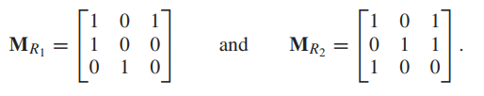
Suppose that the relations R1 and R2 on a set A are represented by the matrices
What are the matrices representing R1 ∪ R2 and R1 ∩ R2?

Slide 32
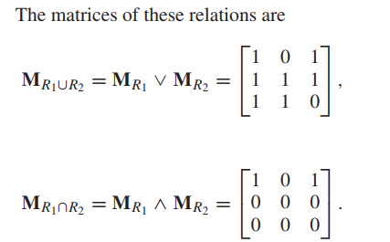

Slide 33

We now turn our attention to determining the matrix for the composite of relations. This matrix can be found using the Boolean product of the matrices for these relations. In particular, suppose that R is a relation from A to B and S is a relation from B to C. Suppose that A, B, and C have m, n, and p elements, respectively.
Let the zero– one matrices for S ◦R, R, and S be M_{S ◦R} = [t_{ij}], M_{R} = [r_{ij}], and M_{S} = [s_{ij}], respectively (these matrices have sizes m × p, m × n, and n × p, respectively).
The ordered pair (a_{i}, c_{j}) belongs to S ◦R if and only if there is an element b_{k} such that (a_{i}, b_{k}) belongs to R and (b_{k}, c_{j}) belongs to S. It follows that t_{ij} = 1 if and only if r_{ik} = s_{kj} = 1 for some k. From the definition of the Boolean product, this means that

Slide 34
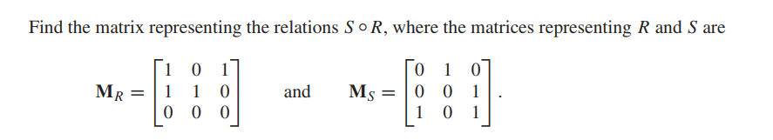
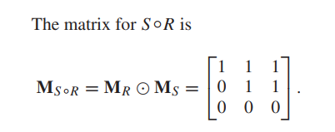
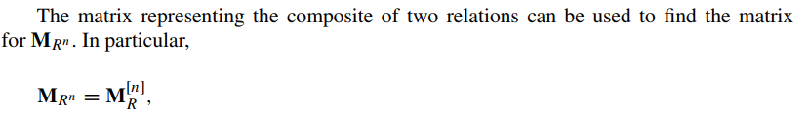
Example

Slide 35
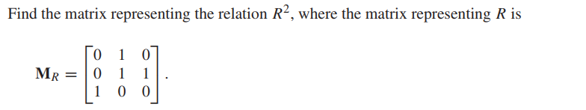
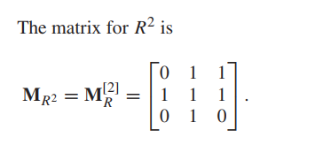
Example

Slide 36
Using the Matrix Representation (1)
A 0-1 matrix representation makes it very easy to check whether or not a relation is
Reflexive
Symmetric
Antisymmetric
Reflexivity
For R to be reflexive, ∀a (a,a)∈R
In M_{R}, R is reflexive iff m_{i,i}=1 for i=1,2,…,n
We check only the diagonal

Slide 37
Using the Matrix Representation (2)
Symmetry
R is symmetric iff for all pairs (a,b) aRb⇒bRa
In M_{R}, this is equivalent to m_{i,j}=m_{j,i} for every pair i,j=1,2,…,n
We check that M_{R}=(M_{R})^{T}
Antisymmetry
R is antisymmetric if m_{i,j}=1 with i≠j, then m_{j,i}=0
Thus, ∀i,j=1,2,…, n, i≠j (m_{i,j}=0) ∨ (m_{j,i}=0)
A simpler logical equivalence is
∀i,j=1,2,…, n, i≠j ¬((m_{i,j}=1) ∧ (m_{j,i}=1))

Slide 38
Matrix Representation: Example
Is R reflexive? Symmetric? Antisymmetric?
M_{R}= | 0 | 0 | 1
 | 1 | 1 | 1
 | 0 | 0 | 1
Clearly R is not reflexive: m_{2,2}=0
It is not symmetric because m_{2,1}=1, m_{1,2}=0
It is however antisymmetric

Slide 39
Matrix Representation: Combining Relations
Combining relations is also simple: union and intersection of relations are nothing more than entry-wise Boolean opertions
Union: An entry in the matrix of the union of two relations R₁∪R₂ is 1 iff at least one of the corresponding entries in R₁ or R₂ is 1. Thus
M_{R1∪R2} = M_{R1}∨ M_{R2}
Intersection: An entry in the matrix of the intersection of two relations R₁∩R₂ is 1 iff both of the corresponding entries in R₁ and R₂ are 1. Thus
M_{R1∩R2} = M_{R1} ∧ M_{R2}
Count the number of operations

Slide 40
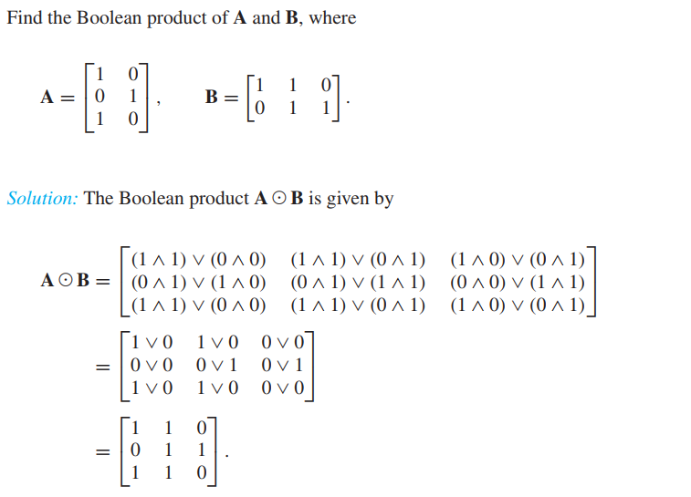

Slide 41
Combining Relations: Example
What is M_{R1∪R2} and M_{R1∩R2}?
How does combining the relations change their properties?
M_{R1} = | 1 | 0 | 1
 | 0 | 1 | 1
 | 1 | 1 | 0
M_{R2} = | 0 | 0 | 0
 | 1 | 1 | 1
 | 0 | 1 | 1
M_{R1∪R2}= | 1 | 0 | 1
 | 1 | 1 | 1
 | 1 | 1 | 1
M_{R1∩R2}= | 0 | 0 | 0
 | 0 | 1 | 1
 | 0 | 1 | 0

Slide 42
Composing Relations: Example
0-1 matrices are also useful for composing matrices. If you have not seen matrix product before, read Section 3.8
M_{R1} = | 1 | 0 | 1
 | 0 | 1 | 1
 | 1 | 1 | 0
M_{R2} = | 0 | 0 | 0
 | 1 | 1 | 1
 | 0 | 1 | 1
M_{R2ο R1}=M_{R1}. M_{R2}= | 0 | 1 | 1
 | 1 | 1 | 1
 | 1 | 1 | 1

Slide 43
Composite Relations: R^{n}
Remember that recursively composing a relation R^{n} ⊆ R for n=1,2,3,… gives a nice characterization of transitivity
Theorem: A relation R is transitive if and only if R^{n} ⊆ R for n=1,2,3,…
We will use
this idea and
the composition by matrix multiplication
to build the Warshall (a.k.a. Roy-Warshall) algorithm, which computed the transitive closure (discussed in the next section)

Slide 44
Example
Let A = {1, 2, 3} and B = {1, 2, 3, 4}. The relations R1 = {(1, 1), (2, 2), (3, 3)} and R2 = {(1, 1), (1, 2), (1, 3), (1, 4)} can be combined to obtain R1 ∪ R2 =
{(1, 1), (1, 2), (1, 3), (1, 4), (2, 2), (3, 3)} R1 ∩ R2 =
{(1, 1)}, R1 - R2 =
{(2, 2), (3, 3)}, R2 - R1 =
{(1, 2), (1, 3), (1, 4)}.

Slide 45
Example
Let A and B be the set of all students and the set of all courses at a school, respectively. Suppose that R1 consists of all ordered pairs (a, b), where a is a student who has taken course b, and R2 consists of all ordered pairs (a, b), where a is a student who requires course b to graduate. What are the relations R1 ∪ R2, R1 ∩ R2, R1 ⊕ R2, R1 - R2, and R2 - R1?
The relation R1 ∪ R2 consists of all ordered pairs (a, b), where a is a student who either has taken course b or needs course b to graduate,
R1 ∩ R2 is the set of all ordered pairs (a, b), where a is a student who has taken course b and needs this course to graduate.

Slide 46
Also, R1 ⊕ R2 consists of all ordered pairs (a, b), where student a has taken course b but does not need it to graduate or needs course b to graduate but has not taken it.
R1 - R2 is the set of ordered pairs (a, b), where a has taken course b but does not need it to graduate; that is, b is an elective course that a has taken.
R2 - R1 is the set of all ordered pairs (a, b), where b is a course that a needs to graduate but has not taken.

Slide 47
Directed Graphs Representation (1)
We briefly introduce them here to use them to represent relations
We have already seen directed graphs to represent functions and relations (between two sets). Those are special graphs, called bipartite directed graphs
For a relation on a set A, it makes more sense to use a general directed graph rather than having two copies of the same set A

Slide 48
Definition
A directed graph, or digraph, consists of a set V of vertices (or nodes) together with a set E of ordered pairs of elements of V called edges (or arcs). The vertex a is called the initial vertex of the edge (a, b), and the vertex b is called the terminal vertex of this edge.

Slide 49
Definition: Directed Graphs (2)
Definition: A G graph consists of
A set V of vertices (or nodes), and
A set E of edges (or arcs)
We note: G=(V,E)
Definition: A directed G graph (digraph) consists of
A set V of vertices (or nodes), and
A set E of edges of ordered pairs of elements of V (of vertices)

Slide 50
Directed Graphs Representation (2)
Example:
Let A= {a₁,a₂,a₃,a₄}
Let R be a relation on A defined as follows
R={(a₁,a₂),(a₁,a₃),(a₁,a₄),(a₂,a₃),(a₂,a₄),(a₃,a₁),(a₃,a₄), (a₄,a₃),(a₄,a₄)}
Draw the digraph representing this relation

Slide 51
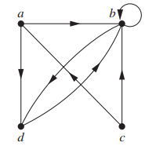
The directed graph with vertices a, b, c, and d, and edges (a, b), (a, d), (b, b), (b, d), (c, a), (c, b), and (d, b):

Slide 52
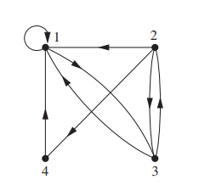
The directed graph of the relation R = {(1, 1), (1, 3), (2, 1), (2, 3), (2, 4), (3, 1), (3, 2), (4, 1)} on the set {1, 2, 3, 4}

Slide 53
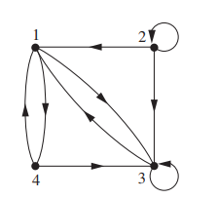
What are the ordered pairs in the relation R represented by the directed graph shown in Figure?
The ordered pairs (x, y) in the relation are R = {(1, 3), (1, 4), (2, 1), (2, 2), (2, 3), (3, 1), (3, 3), (4, 1), (4, 3)}. Each of these pairs corresponds to an edge of the directed graph, with (2, 2) and (3, 3) corresponding to loops.

Slide 54
Using the Digraphs Representation (1)
A directed graph offers some insight into the properties of a relation
Reflexivity: In a digraph, the represented relation is reflexive iff every vertex has a self loop
Symmetry: In a digraph, the represented relation is symmetric iff for every directed edge from a vertex x to a vertex y there is also an edge from y to x

Slide 55
Using the Digraphs Representation (2)
Antisymmetry: A represented relation is antisymmetric iff there is never a back edge for any directed edges between two distinct vertices
Transitivity: A digraph is transitive if for every pair of directed edges (x,y) and (y,z) there is also a directed edge (x,z)
→ This may be harder to visually verify in more complex graphs

Slide 56
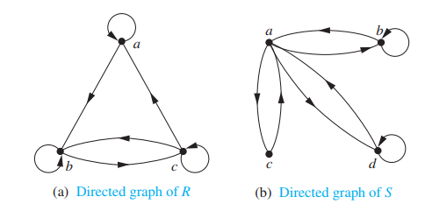
Determine whether the relations for the directed graphs shown in Figure are reflexive, symmetric, antisymmetric, and/or transitive

Slide 57
Because there are loops at every vertex of the directed graph of R, it is reflexive.
R is neither symmetric nor antisymmetric because there is an edge from a to b but not one from b to a, but there are edges in both directions connecting b and c.
Finally, R is not transitive because there is an edge from a to b and an edge from b to c, but no edge from a to c.
Because loops are not present at all the vertices of the directed graph of S, this relation is not reflexive.
It is symmetric and not antisymmetric, because every edge between distinct vertices is accompanied by an edge in the opposite direction.
It is also not hard to see from the directed graph that S is not transitive, because (c, a) and (a, b) belong to S, but (c, b) does not belong to S.

Slide 58
Closures: Definitions
If a given relation R
is not reflexive (or symmetric, antisymmetric, transitive)
How can we transform it into a relation R’ that is?
Example: Let R={(1,2),(2,1),(2,2),(3,1),(3,3)}
How can we make it reflexive?
In general we would like to change the relation as little as possible
To make R reflexive, we simply add (1,1) to the set
Inducing a property on a relation is called its closure.
Above, R’=R ∪{(1,1)} is called the reflexive closure

Slide 59
Reflexive Closure
In general, the reflexive closure of a relation R on A is R∪Δ where Δ={ (a,a) | a∈A}
Δ is the diagonal relation on A

Slide 60
Symmetric Closure
Similarly, we can create the symmetric closure using the inverse of the relation R.
The symmetric closer is, R∪R’ where
R’={ (b,a) | (a,b)∈R }

Slide 61
Paths in Directed Graphs
A path from a to b in the directed graph G is a sequence of edges (x₀, x₁), (x₁, x₂), (x₂, x₃), . . . , (x_{n−1}, x_{n}) in G, where n is a nonnegative integer, and x₀ = a and x_{n} = b,
that is, a sequence of edges where the terminal vertex of an edge is the same as the initial vertex in the next edge in the path. This path is denoted by x₀, x₁, x₂, . . . , x_{n−1}, x_{n} and has length n. We view the empty set of edges as a path of length zero from a to a.
A path of length n ≥ 1 that begins and ends at the same vertex is called a circuit or cycle.
A path in a directed graph can pass through a vertex more than once. Moreover, an edge in a directed graph can occur more than once in a path.
A path in a directed graph is obtained by traversing along edges (in the same direction as indicated by the arrow on the edge)

Slide 62
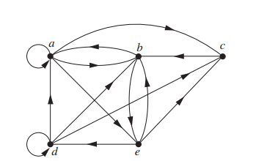
Example
Which of the following are paths in the directed graph shown in Figure 1: a, b, e, d; a, e, c, d, b; b, a, c, b, a, a, b; d, c; c, b, a; e, b, a, b, a, b, e? What are the lengths of those that are paths? Which of the paths in this list are circuits?

Slide 63
Because each of (a, b), (b, e), and (e, d) is an edge, a, b, e, d is a path of length three. Because (c, d) is not an edge, a, e, c, d, b is not a path. Also, b, a, c, b, a, a, b is a path of length six because (b, a), (a, c), (c, b), (b, a), (a, a), and (a, b) are all edges.
We see that d, c is a path of length one, because (d, c) is an edge. Also c, b, a is a path of length two, because (c, b) and (b, a) are edges. All of (e, b), (b, a), (a, b), (b, a), (a, b), and (b, e) are edges, so e, b, a, b, a, b, e is a path of length six.
The two paths b, a, c, b, a, a, b and e, b, a, b, a, b, e are circuits because they begin and end at the same vertex. The paths a, b, e, d; c, b, a; and d, c are not circuits.

Slide 64
Transitive Closure
To compute the transitive closure we use the theorem
Theorem: A relation R is transitive if and only if R^{n} ⊆ R for n=1,2,3,…
Thus, if we compute R^{k} such that R^{k} ⊆ R^{n} for all n≥k, then R^{k} is the transitive closure
The Warshall’s Algorithm allows us to do this efficiently
We now show that finding the transitive closure of a relation is equivalent to determining which pairs of vertices in the associated directed graph are connected by a path. With this in mind, we define a new relation.

Slide 65
Let M_{R} be the zero–one matrix of the relation R on a set with n elements. Then the zero–one
matrix of the transitive closure R∗ is
M_{R∗} = M_{R} ∨ M_{R}^{[2]} ∨ M_{R}^{[3]} ∨ · · · ∨ M_{R}^{[n]}.

Slide 66
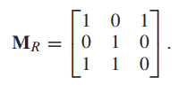
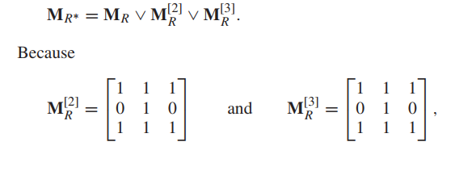
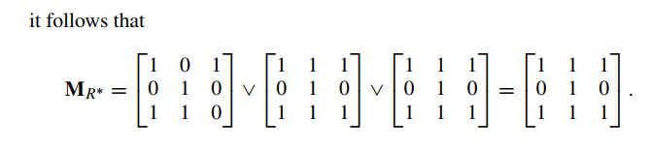
Find the zero–one matrix of the transitive closure of the relation R where

Slide 67
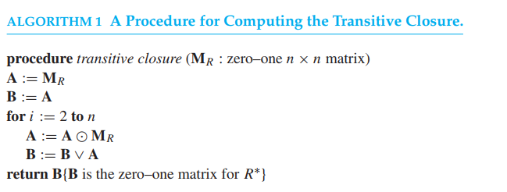

Slide 68
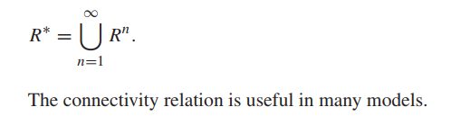
Let R be a relation on a set A. The connectivity relation R∗ consists of the pairs (a, b) such that there is a path of length at least one from a to b in R.
Because R^{n} consists of the pairs (a, b) such that there is a path of length n from a to b, it follows that R∗ is the union of all the sets R^{n}. In other words,

Slide 69
Warshall’s Algorithm: Key Ideas
In any set A with |A|=n, any transitive relation will be built from a sequence of relations that has a length of at most n. Why?
Consider the case where the relation R on A has the ordered pairs (a₁,a₂),(a₂,a₃),…,(a_{n-1},a_{n}). Then, (a₁,a_{n}) must be in R for R to be transitive
Thus, by the previous theorem, it suffices to compute (at most) R^{n}
Recall that R^{k}=R^{ο}R^{k-1} is computed using a bit-matrix product
The above gives us a natural algorithm for computing the transitive closure: the Warshall’s Algorithm

Slide 70
Warshall’s Algorithm
Input: An (n×n) 0-1 matrix M_{R} representing a relation R on A, |A|=n
Output: An (n×n) 0-1 matrix W representing the transitive closure of R on A
1. W← M_{R}
2. FOR k=1,…, n DO
FOR i=1,…,n DO
FOR j=1,…,n DO
w_{i,j} ← w_{i.j} ∨ (w_{i,k} ∧ w_{k,j})
END
END
END
RETURN W

Slide 71
Warshall’s Algorithm: Example
Compute the transitive closure of
The relation R={(1,1),(1,2),(1,4),(2,2),(2,3),(3,1),
(3,4),(4,1),(4,4)}
On the set A={1,2,3,4}

Slide 72
Equivalence Relations
Section 9.5

Slide 73
Section Summary
Equivalence Relations
Equivalence Classes
Equivalence Classes and Partitions

Slide 74
Equivalence Relations
Definition 1: A relation on a set A is called an equivalence relation if it is reflexive, symmetric, and transitive.
Definition 2: Two elements a, and b that are related by an equivalence relation are called equivalent. The notation a ∼ b is often used to denote that a and b are equivalent elements with respect to a particular equivalence relation.

Slide 75
Let R be the relation on the set of real numbers such that aRb if and only if a - b is an integer. Is R an equivalence relation?
Because a - a = 0 is an integer for all real numbers a, aRa for all real numbers a. Hence, R is reflexive. Now suppose that aRb. Then a - b is an integer, so b - a is also an integer. Hence, bRa. It follows that R is symmetric.
If aRb and bRc, then a - b and b – c are integers. Therefore, a - c = (a - b) + (b - c) is also an integer. Hence, aRc. Thus, R is transitive. Consequently, R is an equivalence relation.
One of the most widely used equivalence relations is congruence modulo m, where m is an integer greater than 1

Slide 76
Congruence Modulo m
Example: Let m be an integer with m > 1. Show that the relation
R = {(a,b) | a ≡ b (mod m)}
is an equivalence relation on the set of integers.
Solution: Recall that a ≡ b (mod m) if and only if m divides a − b.
Reflexivity: a ≡ a (mod m) since a − a = 0 is divisible by m since 0 = 0 ∙ m.
Symmetry: Suppose that a ≡ b (mod m). Then a − b is divisible by m, and so a − b = km, where k is an integer. It follows that b − a = (− k) m, so b ≡ a (mod m).
Transitivity: Suppose that a ≡ b (mod m) and b ≡ c (mod m). Then m divides both a − b and b − c. Hence, there are integers k and l with a − b = km and b − c = lm. We obtain by adding the equations:
a − c = (a − b) + (b − c) = km + lm = (k + l) m.
Therefore, a ≡ c (mod m).

Slide 77
Strings
Example: Suppose that R is the relation on the set of strings of English letters such that aRb if and only if l(a) = l(b), where l(x) is the length of the string x. Is R an equivalence relation?
Solution: Show that all of the properties of an equivalence relation hold.
Reflexivity: Because l(a) = l(a), it follows that aRa for all strings a.
Symmetry: Suppose that aRb. Since l(a) = l(b), l(b) = l(a) also holds and bRa.
Transitivity: Suppose that aRb and bRc. Since l(a) = l(b),and l(b) = l(c), l(a) = l(a) also holds and aRc.

Slide 78
Divides
Example: Show that the “divides” relation on the set of positive integers is not an equivalence relation.
Solution: “divides” is not an equivalence relation.
Reflexivity: a ∣ a for all a.
Not Symmetric: For example, 2 ∣ 4, but 4 ∤ 2. Hence, the relation is not symmetric.
Transitivity: Suppose that a divides b and b divides c. Then there are positive integers k and l such that b = ak and c = bl. Hence, c = a(kl), so a divides c. Therefore, the relation is transitive.

Slide 79
Let R be the relation on the set of real numbers such that xR y if and only if x and y are real numbers that differ by less than 1, that is |x - y| < 1. Show that R is not an equivalence relation.
R is reflexive because |x - x| = 0 < 1 whenever x ∈ R. R is symmetric, for if xR y, where x and y are real numbers, then |x - y| < 1, which tells us that |y - x| = |x - y| < 1, so that yRx. However, R is not an equivalence relation because it is not transitive.
Take x = 2.8, y = 1.9, and z = 1.1, so that |x - y| = |2.8 - 1.9| = 0.9 < 1, |y - z| = |1.9 - 1.1| = 0.8 < 1,
but |x - z| = |2.8 - 1.1| = 1.7 > 1. That is, 2.8R 1.9, 1.9R 1.1, but 2.8R 1.1.

Slide 80
Equivalence Class Concept
Let A be the set of all students in your school who graduated from high school. Consider the relation R on A that consists of all pairs (x, y), where x and y graduated from the same high school.
Given a student x, we can form the set of all students equivalent to x with respect to R. This set consists of all students who graduated from the same high school as x did. This subset of A is called an equivalence class of the relation.

Slide 81
Equivalence Classes
Definition 3: Let R be an equivalence relation on a set A. The set of all elements that are related to an element a of A is called the equivalence class of a. The equivalence class of a with respect to R is denoted by [a]_{R}.
When only one relation is under consideration, we can write [a], without the subscript R, for this equivalence class.
Note that [a]_{R} = {s|(a,s) ∈ R}.
If b ∈ [a]_{R}, then b is called a representative of this equivalence class. Any element of a class can be used as a representative of the class.
The equivalence classes of the relation congruence modulo m are called the congruence classes modulo m. The congruence class of an integer a modulo m is denoted by [a]_{m}, so [a]_{m} = {…, a−2m, a−m, a+2m, a+2m, … }. For example,
[0]₄ = {…, −8, −4 , 0, 4 , 8 , …} [1]₄ = {…, −7, −3 , 1, 5 , 9 , …}
[2]₄ = {…, −6, −2 , 2, 6 , 10 , …} [3]₄ = {…, −5, −1 , 3, 7 , 11 , …}

Slide 82
What is the equivalence class of an integer for the equivalence relation of following?
Let R be the relation on the set of integers such that aRb if and only if a = b or a = -b. We showed that R is reflexive, symmetric, and transitive. It follows that R is an equivalence relation.
Because an integer is equivalent to itself and its negative in this equivalence relation, it follows that [a] = {−a, a}. This set contains two distinct integers unless a = 0. For instance,
[7] = {−7, 7}, [−5] = {−5, 5}, and [0] = {0}.

Slide 83
What are the equivalence classes of 0 and 1 for congruence modulo 4?
The equivalence class of 0 contains all integers a such that a ≡ 0 (mod 4). The integers in this class are those divisible by 4. Hence, the equivalence class of 0 for this relation is [0] = {. . . , -8, -4, 0, 4, 8, . . . }.
The equivalence class of 1 contains all the integers a such that a ≡ 1 (mod 4). The integers in this class are those that have a remainder of 1 when divided by 4. Hence, the equivalence class of 1 for this relation is [1] = {. . . , -7, -3, 1, 5, 9, . . . }.

Slide 84
What is the equivalence class of the string 0111 with respect to the equivalence relation Ron the set of all bit strings? (Recall that sR3 t if and only if s and t are bit strings with s = t or s and t are strings of at least three bits that start with the same three bits.)
The bit strings equivalent to 0111 are the bit strings with at least three bits that begin with 011. These are the bit strings 011, 0110, 0111, 01100, 01101, 01110, 01111, and so on. Consequently, [011]R3 = {011, 0110, 0111, 01100, 01101, 01110, 01111, . . .}.

Slide 85
Equivalence Classes and Partitions
Theorem 1: let R be an equivalence relation on a set A. These statements for elements a and b of A are equivalent:
(i) aRb
(ii) [a] = [b]
(iii) [a] ∩ [b] = ∅
Proof: We show that (i) implies (ii). Assume that aRb. Now suppose that c ∈ [a]. Then aRc. Because aRb and R is symmetric, bRa. Because R is transitive and bRa and aRc, it follows that bRc. Hence, c ∈ [b]. Therefore, [a]⊆ [b]. A similar argument (omitted here) shows that [b]⊆ [a]. Since [a]⊆ [b] and [b]⊆ [a], we have shown that [a] = [b].

Slide 86
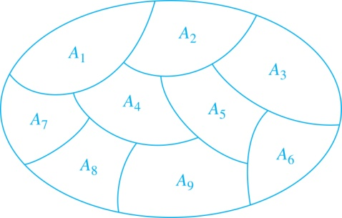
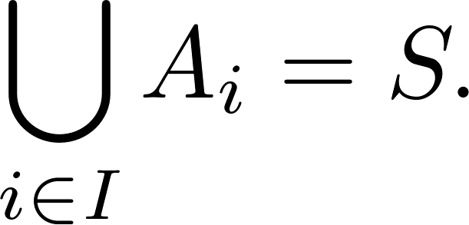
Partition of a Set
Definition: A partition of a set S is a collection of disjoint nonempty subsets of S that have S as their union. In other words, the collection of subsets A_{i}, where i ∈ I (where I is an index set), forms a partition of S if and only if
A_{i} ≠ ∅ for i ∈ I,
A_{i} ∩ A_{j}=∅ when i ≠ j,
and
A Partition of a Set

Slide 87
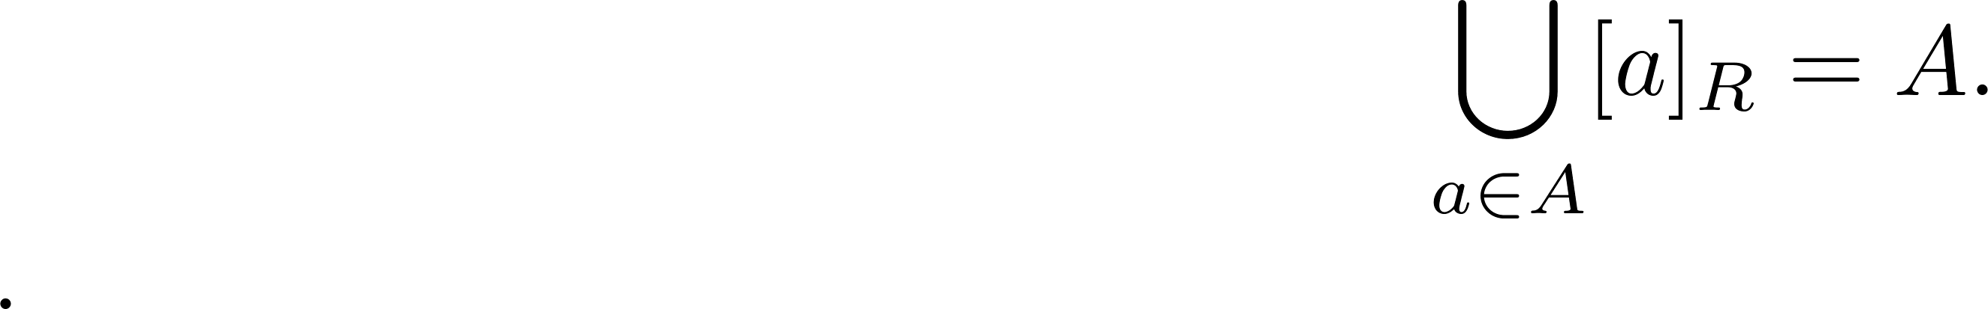
An Equivalence Relation Partitions a Set
Let R be an equivalence relation on a set A. The union of all the equivalence classes of R is all of A, since an element a of A is in its own equivalence class [a]_{R}. In other words,
From Theorem 1, it follows that these equivalence classes are either equal or disjoint, so [a]_{R} ∩[b]_{R}=∅ when [a]_{R} ≠ [b]_{R}.
Therefore, the equivalence classes form a partition of A, because they split A into disjoint subsets.

Slide 88
An Equivalence Relation Partitions a Set (continued)
Theorem 2: Let R be an equivalence relation on a set S. Then the equivalence classes of R form a partition of S. Conversely, given a partition {A_{i} | i ∈ I} of the set S, there is an equivalence relation R that has the sets A_{i}, i ∈ I, as its equivalence classes.
Proof: We have already shown the first part of the theorem.
For the second part, assume that {A_{i} | i ∈ I} is a partition of S. Let R be the relation on S consisting of the pairs (x, y) where x and y belong to the same subset A_{i} in the partition. We must show that R satisfies the properties of an equivalence relation.
Reflexivity: For every a ∈ S, (a,a) ∈ R, because a is in the same subset as itself.
Symmetry: If (a,b) ∈ R, then b and a are in the same subset of the partition, so (b,a) ∈ R.
Transitivity: If (a,b) ∈ R and (b,c) ∈ R, then a and b are in the same subset of the partition, as are b and c. Since the subsets are disjoint and b belongs to both, the two subsets of the partition must be identical. Therefore, (a,c) ∈ R since a and c belong to the same subset of the partition.

Slide 89
List the ordered pairs in the equivalence relation R produced by the partition A1 = {1, 2, 3}, A2 = {4, 5}, and A3 = {6} of S = {1, 2, 3, 4, 5, 6},
The subsets in the partition are the equivalence classes of R. The pair (a, b) ∈ R if and only if a and b are in the same subset of the partition.
The pairs (1, 1), (1, 2), (1, 3), (2, 1), (2, 2), (2, 3), (3, 1), (3, 2), and (3, 3) belong to R because A1 = {1, 2, 3} is an equivalence class; the pairs (4, 4), (4, 5), (5, 4), and (5, 5) belong to R because A2 = {4, 5} is an equivalence class;
and finally the pair (6, 6) belongs to R because {6} is an equivalence class. No pair other than those listed belongs to R.

Slide 90
What are the sets in the partition of the integers arising from congruence modulo 4? There are four congruence classes, corresponding to [0]4, [1]4, [2]4, and [3]4. They are the sets
[0]4 = {. . . , -8, -4, 0, 4, 8, . . . }, [1]4 = {. . . , -7, -3, 1, 5, 9, . . . }, [2]4 = {. . . , -6, -2, 2, 6, 10, . . . }, [3]4 = {. . . , -5, -1, 3, 7, 11, . . . }.
These congruence classes are disjoint, and every integer is in exactly one of them. In other words, as Theorem 2 says, these congruence classes form a partition.

Slide 91
Example
Which of these relations on {0, 1, 2, 3} are equivalence relations? Determine the properties of an equivalence relation that the others lack a) {(0, 0), (1, 1), (2, 2), (3, 3)} b) {(0, 0), (0, 2), (2, 0), (2, 2), (2, 3), (3, 2), (3, 3)} c) {(0, 0), (1, 1), (1, 2), (2, 1), (2, 2), (3, 3)} d) {(0, 0), (1, 1), (1, 3), (2, 2), (2, 3), (3, 1), (3, 2), (3, 3)} e) {(0, 0), (0, 1), (0, 2), (1, 0), (1, 1), (1, 2), (2, 0), (2, 2), (3, 3)}

Slide 93
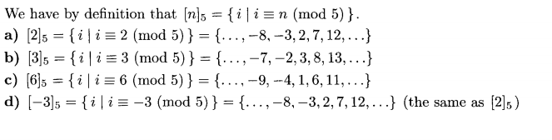
Example
What is the congruence class [n]5 (that is, the equivalence class of n with respect to congruence modulo 5) when n is a) 2? b) 3? c) 6? d) -3?

Slide 94
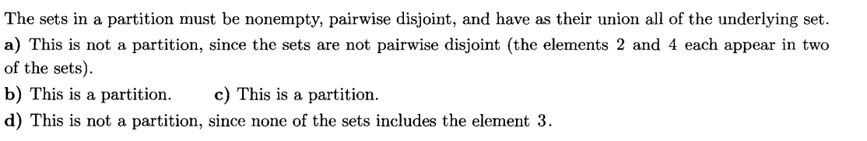
Example
Which of these collections of subsets are partitions of {1, 2, 3, 4, 5, 6}? a) {1, 2},{2, 3, 4},{4, 5, 6} b) {1}, {2, 3, 6}, {4}, {5} c) {2, 4, 6}, {1, 3, 5} d) {1, 4, 5}, {2, 6}

Slide 95
Partial Orderings
Section 9.6

Slide 96
Section Summary
Partial Orderings and Partially-ordered Sets
Lexicographic Orderings
Hasse Diagrams
Lattices (not currently in overheads)
Topological Sorting (not currently in overheads)

Slide 97
Partial Orderings
Definition 1: A relation R on a set S is called a partial ordering, or partial order, if it is reflexive, antisymmetric, and transitive. A set together with a partial ordering R is called a partially ordered set, or poset, and is denoted by (S, R). Members of S are called elements of the poset.

Slide 98
Partial Orderings (continued)
Example 1: Show that the “greater than or equal” relation (≥) is a partial ordering on the set of integers.
Reflexivity: a ≥ a for every integer a.
Antisymmetry: If a ≥ b and b ≥ a , then a = b.
Transitivity: If a ≥ b and b ≥ c , then a ≥ c.

Slide 99
Partial Orderings (continued)
Example 2: Show that the divisibility relation (∣) is a partial ordering on the set of integers.
Reflexivity: a ∣ a for all integers a.
Antisymmetry: If a and b are positive integers with a | b and b | a, then a = b.
Transitivity: Suppose that a divides b and b divides c. Then there are positive integers k and l such that b = ak and c = bl. Hence, c = a(kl), so a divides c. Therefore, the relation is transitive.
(Z⁺, ∣) is a poset.

Slide 100
Partial Orderings (continued)
Example 3: Show that the inclusion relation (⊆) is a partial ordering on the power set of a set S.
Reflexivity: A ⊆ A whenever A is a subset of S.
Antisymmetry: If A and B are positive integers with A ⊆ B and B ⊆ A, then A = B.
Transitivity: If A ⊆ B and B ⊆ C, then A ⊆ C.
The properties all follow from the definition of set inclusion.

Slide 101
Comparability
Definition 2: The elements a and b of a poset (S,≼ ) are comparable if either a ≼ b or b ≼ a. When a and b are elements of S so that neither a ≼ b nor b ≼ a, then a and b are called incomparable.
The symbol ≼ is used to denote the relation in any poset.

Slide 102
In the poset (Z+, |), are the integers 3 and 9 comparable? Are 5 and 7 comparable?
The integers 3 and 9 are comparable, because 3 | 9. The integers 5 and 7 are incomparable, because 5 | 7 and 7 | 5.
The adjective “partial” is used to describe partial orderings because pairs of elements may be incomparable. When every two elements in the set are comparable, the relation is called a total ordering.

Slide 103
Definition 3: If (S,≼ ) is a poset and every two elements of S are comparable, S is called a totally ordered or linearly ordered set, and ≼ is called a total order or a linear order. A totally ordered set is also called a chain.

Slide 104
The poset (Z, ≤) is totally ordered, because a ≤ b or b ≤ a whenever a and b are integers.
The poset (Z+, | ) is not totally ordered because it contains elements that are incomparable, such as 5 and 7
we noted that (Z+, ≤) is well-ordered, where ≤ is the usual “less than or equal to” relation. We now define well-ordered sets.

Slide 105
Definition 4: (S,≼ ) is a well-ordered set if it is a poset such that ≼ is a total ordering and every nonempty subset of S has a least element.

Slide 106
The set of ordered pairs of positive integers, Z+× Z+, with (a1, a2) ≼(b1, b2) if a1 < b1, or if a1 = b1 and a2 ≤ b2 (the lexicographic ordering), is a well-ordered set.
The set Z, with the usual ≤ ordering, is not well-ordered because the set of negative integers, which is a subset of Z, has no least element.

Slide 107
Lexicographic Order
Definition: Given two posets (A₁,≼₁) and (A₂,≼₂), the lexicographic ordering on A₁ ⨉ A₂ is defined by specifying that (a₁, a₂) is less than (b₁,b₂), that is,
(a₁, a₂) ≺ (b₁,b₂),
either if a₁ ≺₁ b₁ or if a₁ = b₁ and a₂ ≺₂ b₂.
This definition can be easily extended to a lexicographic ordering on strings (see text).
Example: Consider strings of lowercase English letters. A lexicographic ordering can be defined using the ordering of the letters in the alphabet. This is the same ordering as that used in dictionaries.
discreet ≺ discrete, because these strings differ in the seventh position and e ≺ t.
discreet ≺ discreetness, because the first eight letters agree, but the second string is longer.

Slide 108
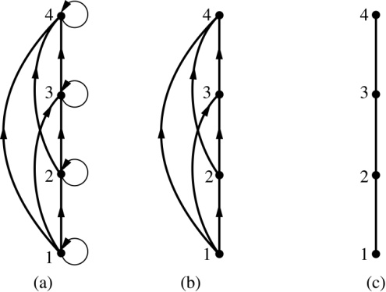
Hasse Diagrams
Definition: A Hasse diagram is a visual representation of a partial ordering that leaves out edges that must be present because of the reflexive and transitive properties.
A partial ordering is shown in (a) of the figure above. The loops due to the reflexive property are deleted in (b). The edges that must be present due to the transitive property are deleted in (c). The Hasse diagram for the partial ordering (a), is depicted in (c).

Slide 109
Procedure for Constructing a Hasse Diagram
To represent a finite poset (S,≼ ) using a Hasse diagram, start with the directed graph of the relation:
Remove the loops (a, a) present at every vertex due to the reflexive property.
Remove all edges (x, y) for which there is an element z ∈ S such that x ≺ z and z ≺ y. These are the edges that must be present due to the transitive property.
Arrange each edge so that its initial vertex is below the terminal vertex. Remove all the arrows, because all edges point upwards toward their terminal vertex.

Slide 110
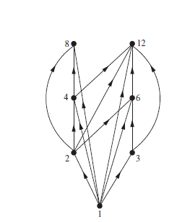
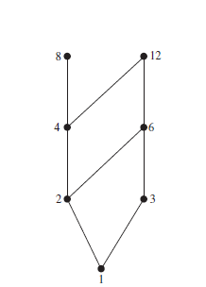
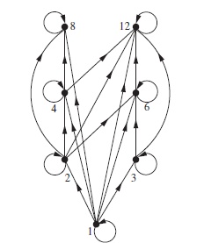
Draw the Hasse diagram representing the partial ordering {(a, b)|a divides b} on {1, 2, 3, 4, 6, 8, 12}.
Begin with the digraph for this partial order, as shown in Figure 3(a). Remove all loops, as shown in Figure 1(b). Then delete all the edges implied by the transitive property. These are (1, 4), (1, 6), (1, 8), (1, 12), (2, 8), (2, 12), and (3, 12). Arrange all edges to point upward, and delete all arrows to obtain the Hasse diagram. The resulting Hasse diagram is shown in Figure 1(c).

Slide 111
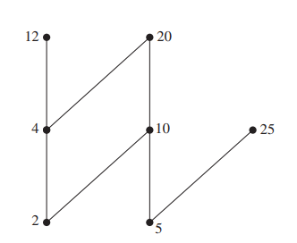
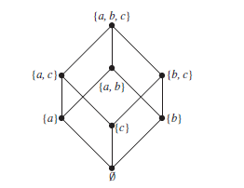
Draw the Hasse diagram for the partial ordering {(A, B) | A ⊆ B} on the power set P (S) where S = {a, b, c}.
The Hasse diagram for this partial ordering is obtained from the associated digraph by deleting all the loops and all the edges that occur from transitivity, namely, (∅, {a, b}), (∅, {a, c}), (∅, {b, c}), (∅, {a, b, c}), ({a}, {a, b, c}), ({b}, {a, b, c}), and ({c}, {a, b, c}). Finally all edges point upward, and arrows are deleted

Slide 112
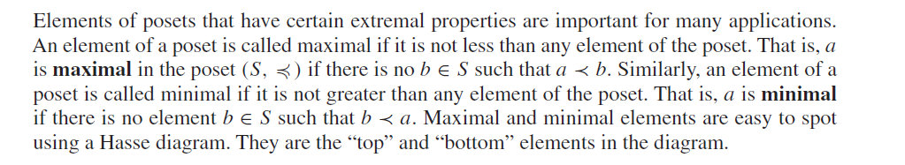
Maximal and Minimal Elements

Slide 113
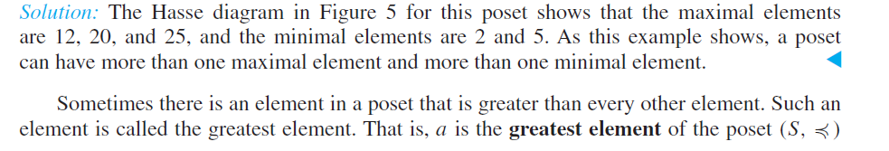
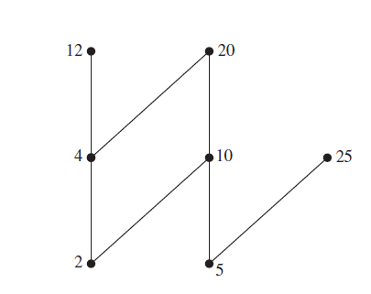

Slide 114
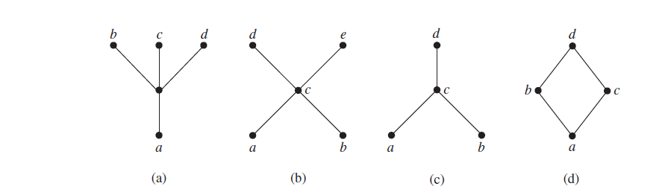
Determine whether the posets represented by each of the Hasse diagrams in above Figure have a greatest element and a least element.
The least element of the poset with Hasse diagram (a) is a. This poset has no greatest element. The poset with Hasse diagram (b) has neither a least nor a greatest element. The poset with Hasse diagram (c) has no least element. Its greatest element is d. The poset with Hasse diagram (d) has least element a and greatest element d.

Slide 115
Let S be a set. Determine whether there is a greatest element and a least element in the poset (P (S),⊆).
Solution: The least element is the empty set, because ∅ ⊆ T for any subset T of S.
The set S is the greatest element in this poset, because T ⊆ S whenever T is a subset of S.

Slide 116
Least Upper and Greatest Lower Bounds
If a is an upper bound for S which is related to all other upper bounds then it is the least upper bound, denoted lub(S). Similarly for the greatest lower bound, glb(S).
Consider the element {a}.
Since{a, b, c}, {a, b} {a, c} and {a}are upper bounds and {a} is related to all of them, {a}must be the lub. It is also the glb.

Slide 117
The element x is called the least upper bound of the subset A if x is an upper bound that is less than every other upper bound of A. Because there is only one such element, if it exists, it makes sense to call this element the least upper bound. That is, x is the least upper bound of A if whenever a ∈ A, and whenever z is an upper bound of A. Similarly, the element y is called the greatest lower bound of A if y is a lower bound of A and whenever z is a lower bound of A. The greatest lower bound of A is unique if it exists.
The greatest lower bound and least upper bound of a subset A are denoted by glb(A) and lub(A), respectively.

Slide 118
Least and Greatest Elements
Let (A, R) be a poset. Then a in A is the least element if for every element b in A, aRb and b is the greatest element if for every element a in A, aRb.

Slide 119
Upper and Lower Bounds
Let S be a subset of A in the poset (A, R). If there exists an element a in A such that sRa for all s in S, then a is called an upper bound. Similarly for lower bounds.
Note: to be an upper bound you must be related to every element in the set. Similarly for lower bounds.

Slide 120
Maximal and Minimal Elements
Let (A, R) be a poset. Then a in A is a minimal element if there does not exist an element b in A such that bRa
Note: there can be more than one minimal and maximal element in a poset.

Slide 121
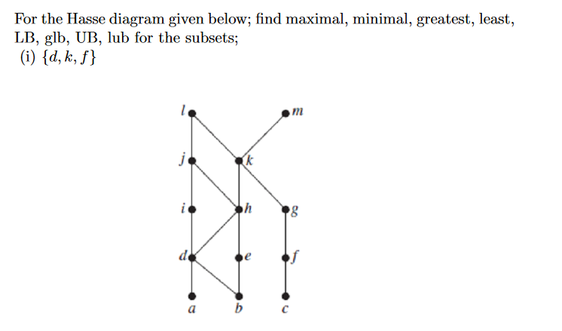
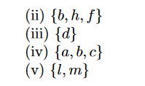
Example

Slide 122
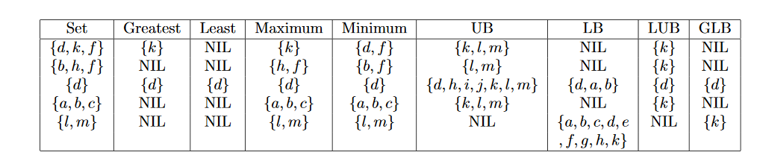
Solution

Slide 123
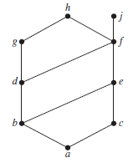
Find the lower and upper bounds of the subsets {a, b, c}, {j, h}, and {a, c, d, f } in the poset with the Hasse diagram shown in Figure 2.
The upper bounds of {a, b, c} are e, f, j, and h, and its only lower bound is a.
There are no upper bounds of {j, h}, and its lower bounds are a, b, c, d, e, and f .
The upper bounds of {a, c, d, f } are f , h, and j , and its lower bound is a.

Slide 124
Find the greatest lower bound and the least upper bound of {b, d, g}, if they exist, in the poset shown in Figure 2
Solution: The upper bounds of {b, d, g} are g and h. Because g ≺ h, g is the least upper bound.
The lower bounds of {b, d, g} are a and b. Because a ≺ b, b is the greatest lower bound

Slide 125
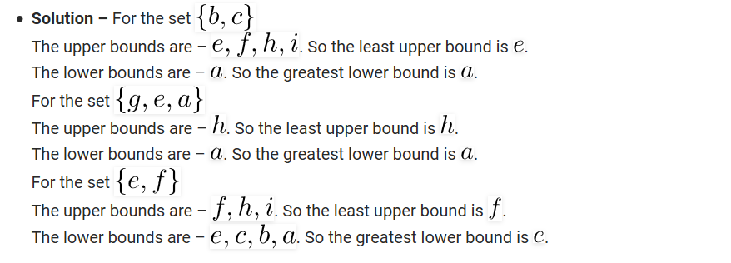
Solution

Slide 126
Find the greatest lower bound and the least upper bound of the sets {3, 9, 12} and {1, 2, 4, 5, 10}, if they exist, in the poset (Z+ , |).
An integer is a lower bound of {3, 9, 12} if 3, 9, and 12 are divisible by this integer. The only such integers are 1 and 3. Because 1 | 3, 3 is the greatest lower bound of {3, 9, 12}. The only lower bound for the set {1, 2, 4, 5, 10} with respect to | is the element 1. Hence, 1 is the greatest lower bound for {1, 2, 4, 5, 10}.
An integer is an upper bound for {3, 9, 12} if and only if it is divisible by 3, 9, and 12. The integers with this property are those divisible by the least common multiple of 3, 9, and 12, which is 36. Hence, 36 is the least upper bound of {3, 9, 12}. A positive integer is an upper bound for the set {1, 2, 4, 5, 10} if and only if it is divisible by 1, 2, 4, 5, and 10. The integers with this property are those integers divisible by the least common multiple of these integers, which is 20. Hence, 20 is the least upper bound of {1, 2, 4, 5, 10}.

Slide 127
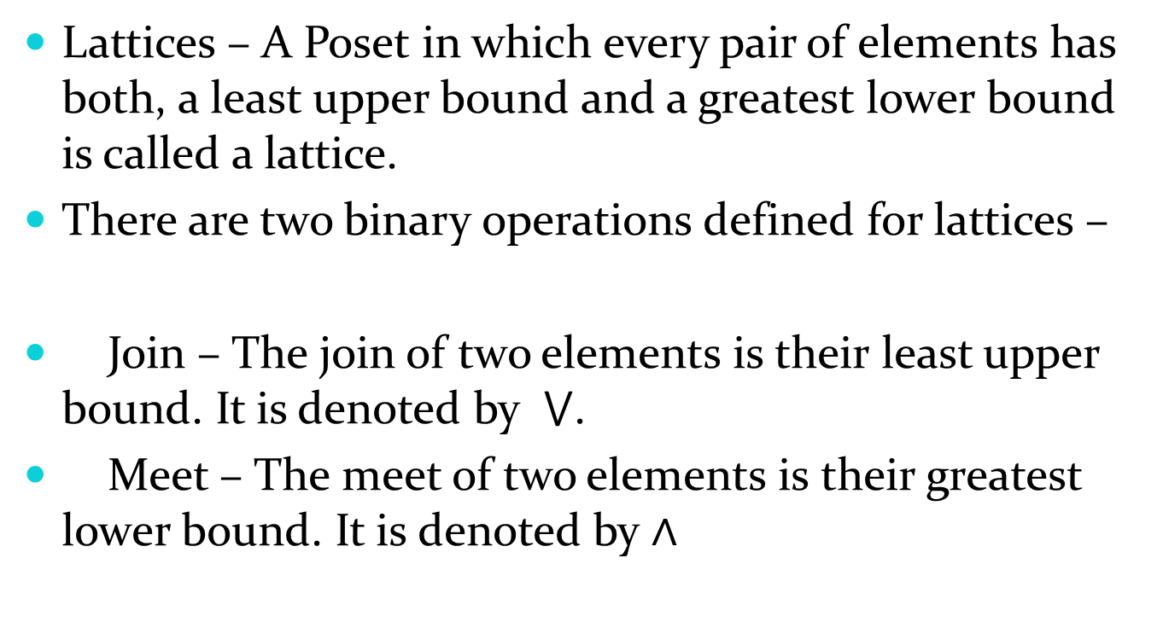
Lattices
Lattices – A Poset in which every pair of elements has both, a least upper bound and a greatest lower bound is called a lattice.
There are two binary operations defined for lattices –
Join – The join of two elements is their least upper bound. It is denoted by $⋁$.
Meet – The meet of two elements is their greatest lower bound. It is denoted by $∧$

Slide 128
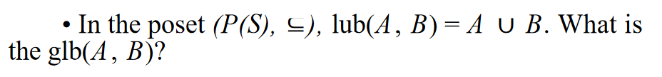
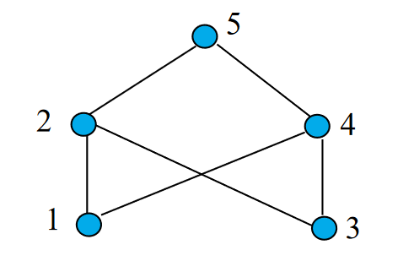
A poset is a lattice if every pair of elements has a lub and a glb.

Slide 129
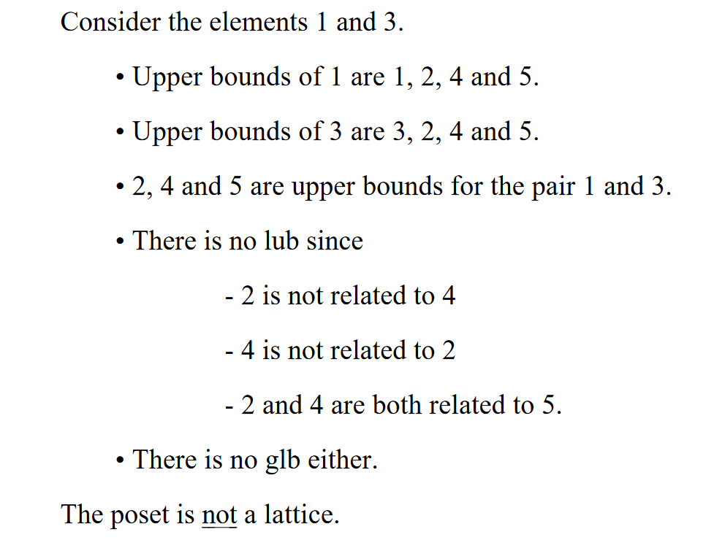

Slide 130
Lattices
A partially ordered set in which every pair of elements has both a least upper bound and a greatest lower bound is called a lattice. Lattices have many special properties. Furthermore, lattices are used in many different applications such as models of information flow and play an important role in Boolean algebra.

Slide 131
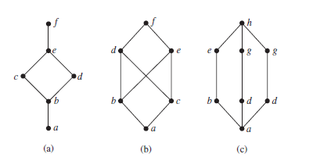
Determine whether the posets represented by each of the Hasse diagrams in Figure 3 are lattices
Solution: The posets represented by the Hasse diagrams in (a) and (c) are both lattices because in each poset every pair of elements has both a least upper bound and a greatest lower bound, as the reader should verify. On the other hand, the poset with the Hasse diagram shown in (b) is not a lattice, because the elements b and c have no least upper bound. To see this, note that each of the elements d, e, and f is an upper bound, but none of these three elements precedes the other two with respect to the ordering of this poset.

Slide 132
Is the poset (Z+ , |) a lattice?
Solution: Let a and b be two positive integers. The least upper bound and greatest lower bound of these two integers are the least common multiple and the greatest common divisor of these integers, respectively, as the reader should verify. It follows that this poset is a lattice.

Slide 133
Determine whether the posets ({1, 2, 3, 4, 5}, |) and ({1, 2, 4, 8, 16}, |) are lattices.
Solution: Because 2 and 3 have no upper bounds in ({1, 2, 3, 4, 5}, |), they certainly do not have a least upper bound. Hence, the first poset is not a lattice.
Every two elements of the second poset have both a least upper bound and a greatest lower bound. The least upper bound of two elements in this poset is the larger of the elements and the greatest lower bound of two elements is the smaller of the elements, as the reader should verify. Hence, this second poset is a lattice

Slide 134
Determine whether (P (S),⊆) is a lattice where S is a set.
Solution: Let A and B be two subsets of S. The least upper bound and the greatest lower bound of A and B are A ∪ B and A ∩ B, respectively, as the reader can show. Hence, (P (S),⊆) is a lattice.

